Slide 1
Cambridge Medical Associates
Patient Safety Improvement Project
Diabetic Eye Exam
Community Learning Session
October 21, 2016
Lindsey Moscato

Slide 2
Aim Statement
Improve Diabetic Eye Exam rate from baseline of 37% to 50% by 12/31/2016.
Why this is important for Patient Safety?
  Prevents Diabetic Retinopathy
  Improved efficiency by becoming part of the morning huddle for providers and developing communication with the patients
  Orders are created in our EMR and tracked to make sure patients are seen by Ophthalmologist and results are communicated with the patient.

Slide 3
Run Chart

Slide 4
Lessons Learned
The importance of
  Data
  Teamwork
  Patient
Surprises –
  How enthusiastic team members were to track progress

Slide 5
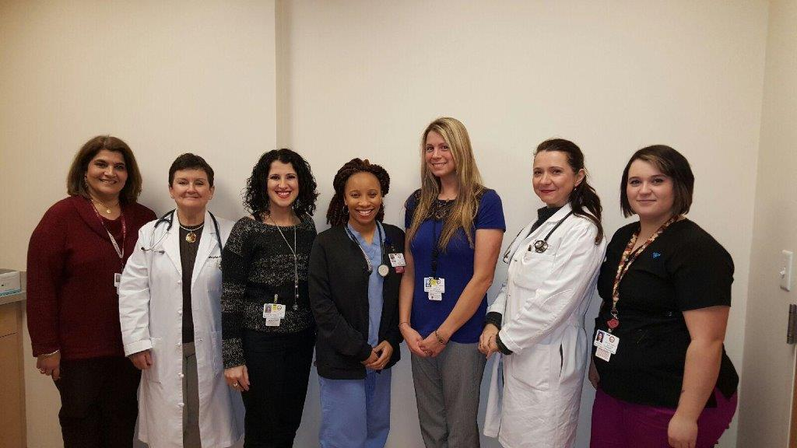
Team Members
Lucy Moushigian:Revenue Cycle Specialist/Medical Secretary
Dr. Marybeth Ferrante: Physician
Christina Rebelo: Referral Coordinator/Medical Secretary
Ricara Moore: Medical Assistant,
Lindsey Moscato: Practice Manager
Alexandra Chabrerie, MD: Physician Champion
Andrea Carreiro: Medical Assistant

Slide 6
Patient Agenda Form
Why this is important for Patient Safety?
  Improved efficiency and workflow by allowing the provider to address all the patients concerns at the visit
  Enhances relationship building with patient and provider
Notes:
Work flow has improved. Wait time for pts has decreased, pt’s do not have to wait in exam rooms for the provider to return. Dr. Chabrerie appreciates the pt agenda form because she is able to go from room to room vs having to find her MA to find out if the pt is here for any other reason.

Slide 7
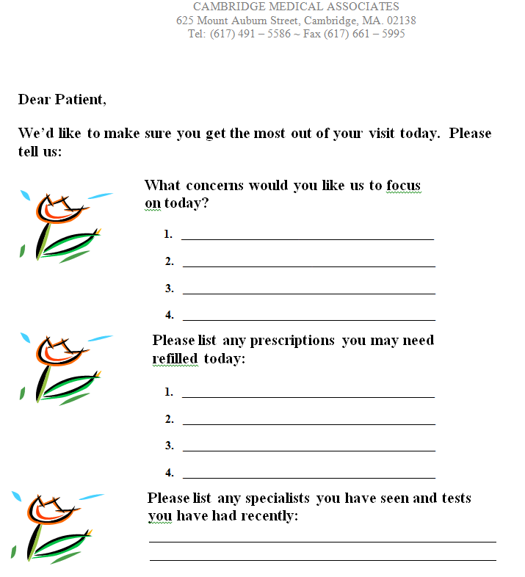

Slide 8

Questions ?

